Slide 1
Week 01, Day 03
CSS
CodeSLO 2018

Slide 2
Git
Did you install Git? We’re going to use it a little later.
If not, try to install it now.
https://git-scm.com/

Slide 3
An Important VS Code Setting
If you haven’t already…
Open VS Code
In the top menu go to View → Toggle Word Wrap and click this option. If your code ever goes off the edge of the right side of the screen, use this option to make it wrap around. This won’t hurt your code.
Alternately, use the keyboard shortcut Alt + Z
Done!

Slide 4
Demo: How to set text-wrapping as the default
Learn how to customize VS Code default settings.

Slide 5
HTML
Yesterday, we worked on some basic HTML.
Today, we’re going to make our HTML a little more sophisticated.
That’s the way CodeSLO works. We start with basics and each class builds on the last.

Slide 6
Doctype, Head, Body, and Comments
There are many parts of an HTML document that are invisible to the user.
Some of these contain information that tells the browser how to display content.
Others contain information that is useful to the developer (that’s you!)

Slide 7
<!DOCTYPE html>
<head>
<!-- head content is invisible to users but still important -->
</head>
<body>
<!-- Body content can be seen by users unless inside a tag -->
<!-- This is a comment. It cannot be seen by users and is meant for the developer. Comments are really useful! -->
</body>

Slide 8
Title
One type of field that goes in the head section of your HTML document is the title. The title shows up on the tab you have a page open in. It is contained within tags, like other content we’ve seen.
<head>
<title>My Page Title</title>
<!-- head content is invisible to users but still important -->
</head>

Slide 9
Exercise One: Add doctype, head and body tags
Open your “How to Google” page from last week’s class
Add Doctype, Head, and Body tags to your document
Add a title to the head section
All of your content from last week goes between the body tags

Slide 10
Let’s talk about style
That How to Google page is a little boring isn’t it? Let’s give it some style.
In web development, HTML defines the content of a page and a technology called CSS -- Cascading Style Sheets -- defines the presentation of that content.
Let’s take a quick look at a How to Google Page without CSS.

Slide 11
Not too Inspiring
Now let’s take the same HTML, but add some CSS styling.

Slide 12
Right?
So, CSS makes a big difference. In that page, the presentation of every element was changed. Fonts were altered. Text size was, as well. Background colors were changed, as were the spacing of elements. Borders were added.Even the basic layout of the text was styled.
The end result is a page that is not only nicer to look at, it is easier to read.
That’s what CSS is for. Presenting your content in a way that will get it consumed by the user.

Slide 13
Speaking of Git… code examples
In this class we’re going to use a program called Git a lot.
Git is a program used for source control.
Source control is simply a way to keep track of different versions of your software. It can be used to separate out development from production code, to safely add new features, or to roll back to an earlier version of your code.
It can also be used to easily copy code, and to make code available to others, which is what we’ll be doing today.
Git revisions are called repositories or repos.

Slide 14
GitHub
GitHub is basically the world’s nexus for open-source software. It is free to use and it’s where we’ll be storing the repos for this class. As this class goes on you’ll get daily practice in cloning, pulling, and pushing repos to Github. Eventually we’ll learn to use it to host our portfolio pages for free.
Right now, let’s do a simple Git command to download the source code for the two How to Google examples you just saw.

Slide 15
Exercise: Git Clone
In VS Code, open a terminal by using the ctrl + ~ keyboard shortcut
In your terminal, type the following command: git clone https://github.com/codeslo/bootcamp-prep
Watch the magic!
You should now have a new sub-folder called bootcamp-prep
Open the folder and you’ll see more sub-folders with many code examples. Find today’s folder to see the How to Google examples.

Slide 16
More Git Later...
In upcoming classes we’ll use Git to keep our source code files up-to-date. We’ll be able to refresh and add new files in seconds.
One thing to keep in mind, is that the bootcamp-prep folder we just created should only be used for source-code. Be sure to create your own projects and exercises in a separate folder. This avoids the possibility of either overwriting your projects or getting Git errors that might seem confusing at this stage.
For now, let’s get back to CSS.

Slide 17
Key Points for CSS
CSS uses Selectors to hook into elements in an HTML document. This is how it knows what elements to style.
CSS uses properties called rules to tell the browser how to style an element
There are thousands of CSS rules and no one knows all of them.
If you find yourself in need of a CSS rule you don’t know, refer to your “how to Google” page.
CSS can be frustrating in the beginning. Like anything, it gets easier the more you use it.

Slide 18
Inline Styling
One simple way to add CSS styling is to write a style property right into an element’s HTML tag. This automatically selects the element in question. Then all you have to do is define a rule or two.
The problem with inline styling is you’d have to add it for every element individually.
<h1 style="color:blue;">This is a Blue Heading</h1>
<h1>This element has no style</h1>

Slide 19
The Internal Style Sheet
A better way to style a page is with a style sheet. A style sheet contains rules that can be used by multiple elements on a page.

Slide 20
<head>
<style>
h1{
color:blue;
}
</style>
</head>
<body>
<h1>This is a blue heading</h1>
<h1>So is this one</h1>
<h2>This element has no style</h2>
</body>

Slide 21
Exercise: Now you make a stylesheet
Make a stylesheet in the head area of your How to Google page.
For now, just include a single rule to make sure everything is working. Don’t forget to refresh your page!
h1{
font-size: 80px;
}

Slide 22
Time to Check In!

Slide 23
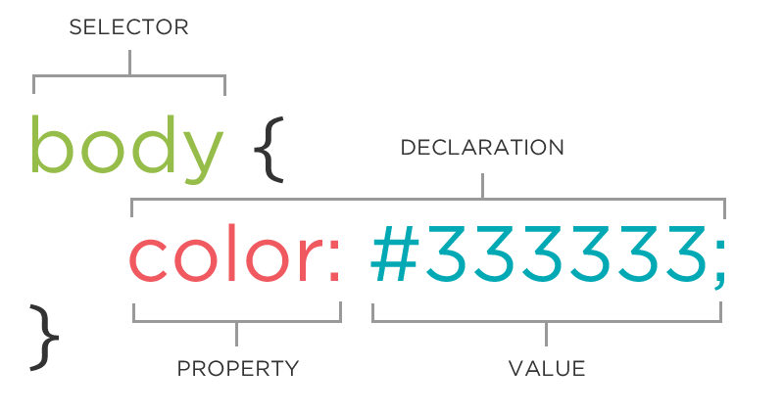
Anatomy of a CSS Rule

Slide 24
Color and Background Color
There are far too many CSS rules for us to go over all of them in this class (not that we know them all) but we’ll go over some common ones.
The color property changes the font color of an element. It can be set to a variety of english-language settings like “red” or “blue” or it can be set using a hex value such as #fffff or #37474F.
The background-color property changes the, well, background color of an element. It is set in the same way as the color property.

Slide 25
Classes and IDs
You can also assign specific selectors to elements in order to style them.
For example, let’s imagine that you wanted to change all the text in one paragraph to aqua and another to gold. In order to do that, we’d assign classes to those elements like this (note, the class names are arbitrary):
<body>
<p class="color-one">This text is aqua</p>
<p class="color-two">This text is gold</p>
</body>

Slide 26
The Difference Between Classes and IDs
IDs can be used for styling in the same way that classes can.
The big difference between the two is semantic. Classes are usually used for styling, while IDs are usually used for hooking into a specific element (such as a button) with JavaScript.
IDs should be unique in a page.
Classes can, and often are, shared by many elements.

Slide 27
Styling with Class
The CSS for styling that text looks like this (note that a period designates a class in CSS):
<style>
.color-one{
color:aqua;
}
.color-two{
color:gold;
}
</style>

Slide 28
Exercise: Colorize it
Assign different classes to various elements on your How to Google page
Using CSS and an internal stylesheet, change the color and background color of these elements.
Go crazy. We’re not going for high art here, we’re just getting comfortable with CSS.

Slide 29
Exercise: Big and Little
1.Make a brand new HTML document called big-and-little.html
2. Add doctype, head, and body sections to your document
3. Add a title and internal stylesheet to your head section
4. In the body section, create two sets of paragraph elements. One should say “big text” the other should say “small text”
5. Assign separate classes to your <p> elements.
6. Give one class a CSS rule of font-size: 24px and the other font-size: 8px
7. Don’t forget semicolons!

Slide 30
Exercise: Margins, Padding, and Borders
Make a new HTML document called box-model.html
Give it doctype, head and body tags with an internal stylesheet in the head
In <body> create an heading element that reads “This is An Element”
Give it a class of “my-box”
Give .my-box a property of border with a value of 2px solid black
Open your new page in a browser.
<style>
.my-box{
border:2px solid black;
}
</style>

Slide 31
Margins, Padding, and Border (cont.)
7. Give .my-box a property of width with a value of 200px
8. Note how the text wraps automatically.
9. Give .my-box a property of padding with a value of 25px;
10. Note how this pushes the border away from the element. Padding goes inside the border.

Slide 32
Margins, Padding and Borders (cont)
11. Now give .my-box a property of margin with a value of 50px
12. Note how this pushes the element away from the edge of the page. Margins go outside of borders

Slide 33
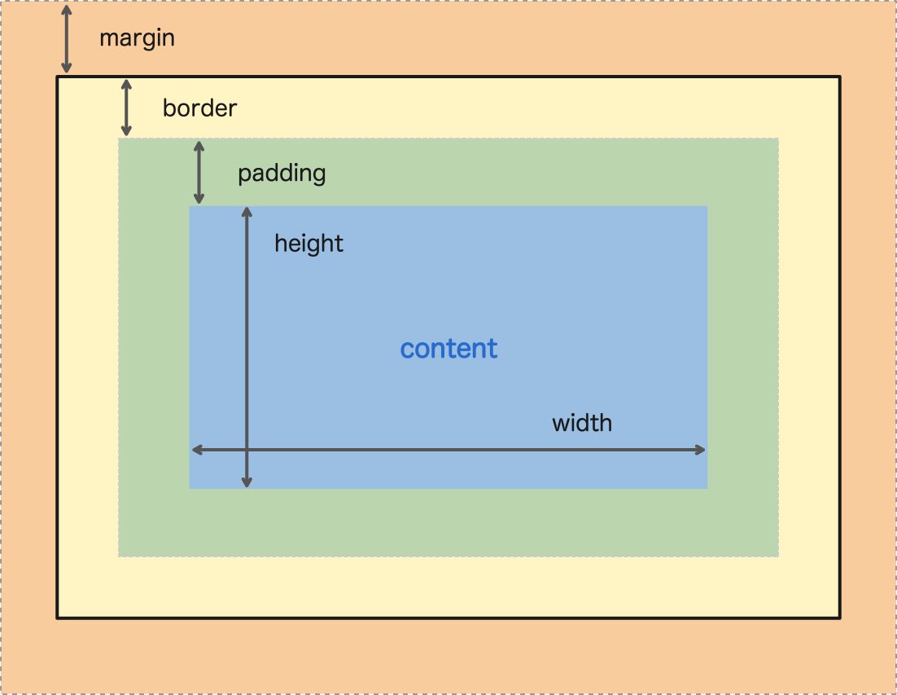
The Box Model
One of the key ideas of CSS is The Box Model

Slide 34
Exercise: See your own box model
Open your box-model.html page in the Chrome Browser
Right-click your element and select inspect element
What you’re seeing now is the Chrome Dev Tools which is one of the most important tools a web developer can have.
Watch our demonstration to see how you can use the dev tools to view the box model for any element in any web page
Try this trick on your How to Google page

Slide 35
Chrome Dev Tools
Of course, the Chrome Dev Tools do a LOT more than just letting us view the box model.
Check out this demonstration for how you can use the Dev Tools to view and change CSS rules for any page.

Slide 36
Coming Up
In our last class for this week we’ll learn about a handy HTML element called a div. We’ll also learn how to use width, height, and the box model to control the placement of elements on a page.
Then we’ll take what we’ve learned and attempt to give our How to Google page some style.

Slide 37
Code On!

